Slide 1

Scrum-agile production
Benefits of a new approach

Slide 2
The Scrum-agile team
Scrum Master
Product Owner
Developer
Tester
Notes:
There are four roles on a scrum team. Scrum Master, Product Owner, Developer, and Tester.

Slide 3

Scrum MASTER
Servant-Leader
Facilitates the Team
Removes Impediments
Notes:
“The Scrum Master is a servant-leader for the Scrum Team. [They] help those outside the Scrum Team understand which of their interactions with the Scrum Team are Helpful and which aren’t” (Cobb, 2015, p. 36). The Scrum Master facilitates scrum events to keep the team organized and focused. One of their main roles is to remove any impediments that the team is facing. They serve the team by helping the team do their jobs more efficiently.

Slide 4
Product owner
Product Backlog Grooming
Represents Business Sponsor
Keeps Team Informed and Organized
Notes:
“The Product Owner is responsible for clearly expressing backlog items and ordering them to keep tasks prioritized” (Cobb, 2015, p. 35). The Product Owner represents the client and has a direct relationship with either the client or the business sponsor. The Product Owner is responsible for keeping the team informed of the clients needs, and keeping the team organized through proper communication.

Slide 5
Developers and testers
Self-Organizing
Cross-Functional
Equally Capable
Notes:
Developers and testers should be able to self-organize the tasks presented by the Product Owner and Scrum Master. They should assign themselves to tasks that are within their skill set. The development team should cumulatively posses the require skills to complete the project at hand. Not every team member is required to have all the skills necessary to complete the project, but as a team they should have the required bases covered.

Slide 6
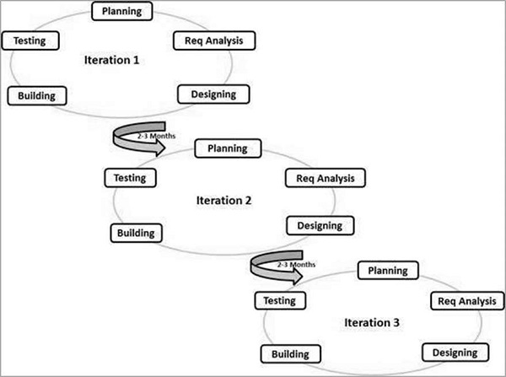
SDLC Phases in agile
Planning
Initial sprint planning
Requirement Analysis
Create attainable product requirements
Designing
Create the architecture
Building
Actual writing of code
Testing
Test and fix product defects
Notes:
The phases of the software development lifestyle in agile are run repeatedly through a series of sprints. A sprint is a single iteration of a project which takes place in four weeks or less.
First there is planning. Each sprint is planned at its outset. The team must decide “Why is this sprint valuable? What can be done this sprint? How will the chosen work get done?” (Schwaber & Sutherland, 2020, p. 7).
Next there is Requirements Analysis. In agile there is an understanding that the requirements might change over the course of the project. For each sprint, the team crates the requirements that are attainable at that point of the project.
Next is designing. In agile this starts with user stories. The Product Owner creates user stories based on the client’s needs. These stories are handed off to developers, who will design the architecture for the code.
Now the developers write the code. In an agile approach the code is written until a defined definition of done is reached. No more work is done than is absolutely necessary.
Finally, the code is tested. Testers will examine the code and look for any bugs. These will be fixed, and the sprint will be ended with a sprint review and sprint retrospective.
All these stages will be repeated until the project is complete.

Slide 7
Agile vs. waterfall
Waterfall Method
Talk to Client
Design Product
Create Product
Receive Feedback
Deliver Product to Client
Agile Method
Talk to Client
Design Product
Create Product
Talk to Client
Amend Product
Notes:
The process of the SNHU Travel project would not have gone as smoothly if we had used a waterfall method vs. using an agile method. Initially, we designed the product based on input from SNHU Travel users. They told us the features that they wanted, and we began to design the app around those wants. During production, SNHU decided that they wanted to focus on “Wellness Travel.” Because we had an open dialog with the client, as well as a flexible approach, we were able to make this adjustment midstream. If we had been using a waterfall method, we would not have been able to adapt, or maybe not even know about the change until the product was delivered.

Slide 8
Agile vs. waterfall
Agile
Waterfall
Pros | Cons
Promotes Teamwork | Required customer engagement
Rapid Development | Not suitable for complex dependencies
Good for Changing requirements | Lack of documentation
Concurrent Development
Flexible
Pros | Cons
Simple to understand | Software takes a long time to develop
Easy to manage | High risk and uncertainty
Good for well defined projects | Hard to adjust scope during the project
Well documented | Not suited for complex projects
(SDLC Tutorial)
Notes:
Both agile and waterfall methods have a place in SDLC.
Agile’s strengths are its flexibility and rapid adaptability. It is best suited for a project that might change and grow. If a client does not have clear expectations or need at the beginning of the project, agile will work best. The client does need to buy in to agile to make it work ideally. If the client is not engaged than part of the benefit of agile is lost.
Waterfall is suited to a well-defined project with low volatility. If the client knows exactly what they want, and the company knows exactly how to deliver it, then waterfall will be a better choice than agile. In waterfall, a company can put down a rigid timeline and expect it to be followed. This can work well if the path is clear. For some groups who are not adept at working with high flexibility, this may make them more productive,

Slide 9
References
Cobb, C. G. (2015). The Project Manager's Guide to Mastering Agile: Principles and practices for an adaptive approach. John Wiley & Sons.
Schwaber, K., & Sutherland, J. (2020). The Scrum Guide The Definitive Guide to Scrum: The Rules of the Game. Creative Commons.
SDLC Tutorial. SDLC - Agile Model. (n.d.). Retrieved October 16, 2021, from https://www.tutorialspoint.com/sdlc/sdlc_agile_model.htm.

